Slide 1
Window Frost Detector
Wouter Huygen, Tom Raeves, Tijs van Alphen and Matthias Wuyts

Slide 2





Block Diagram Overview
Mobile Phone
App
Device
UART
BLE
FCM
Logic
LoRa
TTN Cloud
API
FDService
Backend
Notes:
The main idea we had was to get a notification if our car window is frosted. The octa does some measurements using the temperature/humidity sensor. This data gets send from the device to The Things Network cloud over LoRaWan. From the ttn cloud it gets send to the backend server using MQTT (Message Queuing Telemetry Transport), a lightweight publish-subscribe networkprotocol that uses TCP-UDP. This way the application can get the data using a HTPP GET request. Everytime a new reading comes in on the backend, a notification gets send to the application using FireBase Cloud messaging. We also use BLE to send the alarm we set in the application to the device.

Slide 3
BLE - Chip

Slide 4
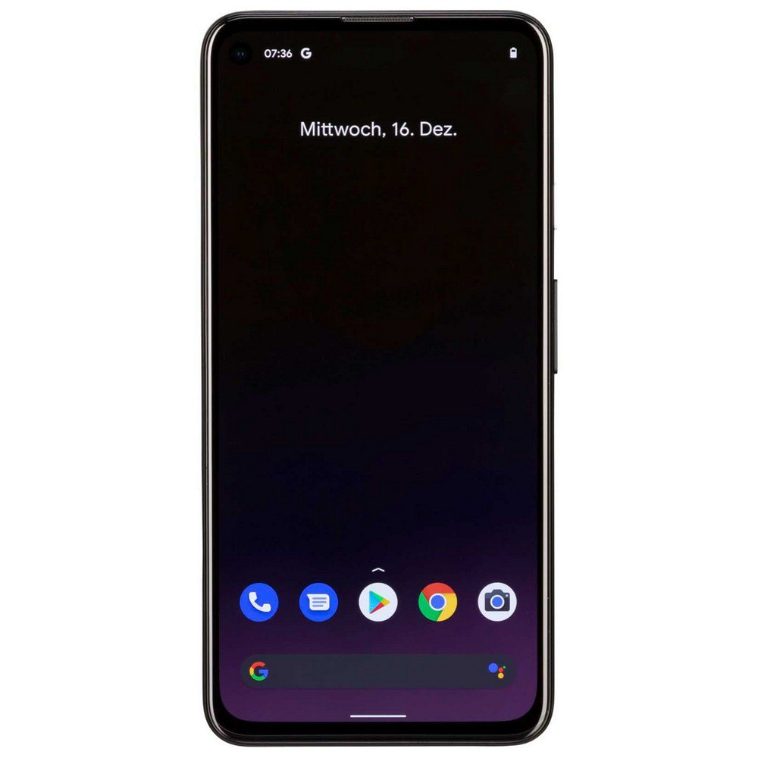
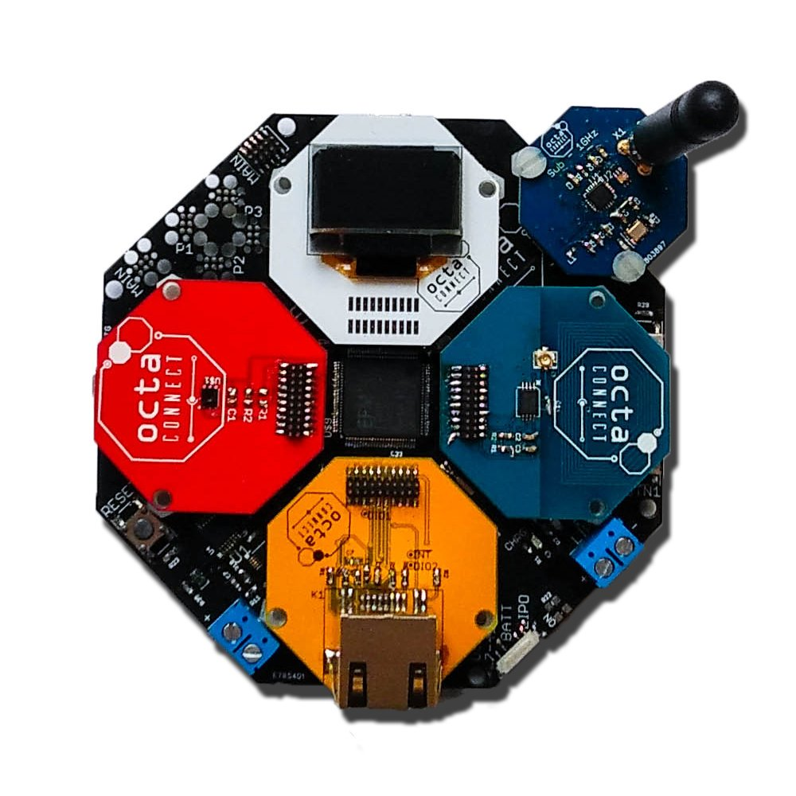
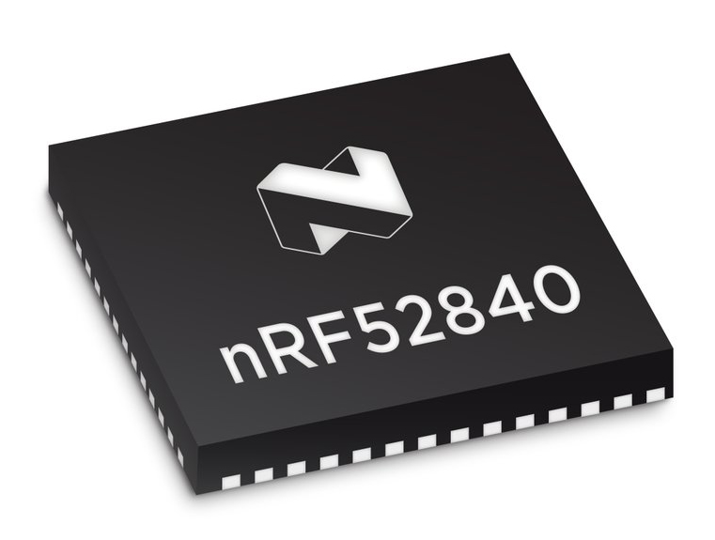
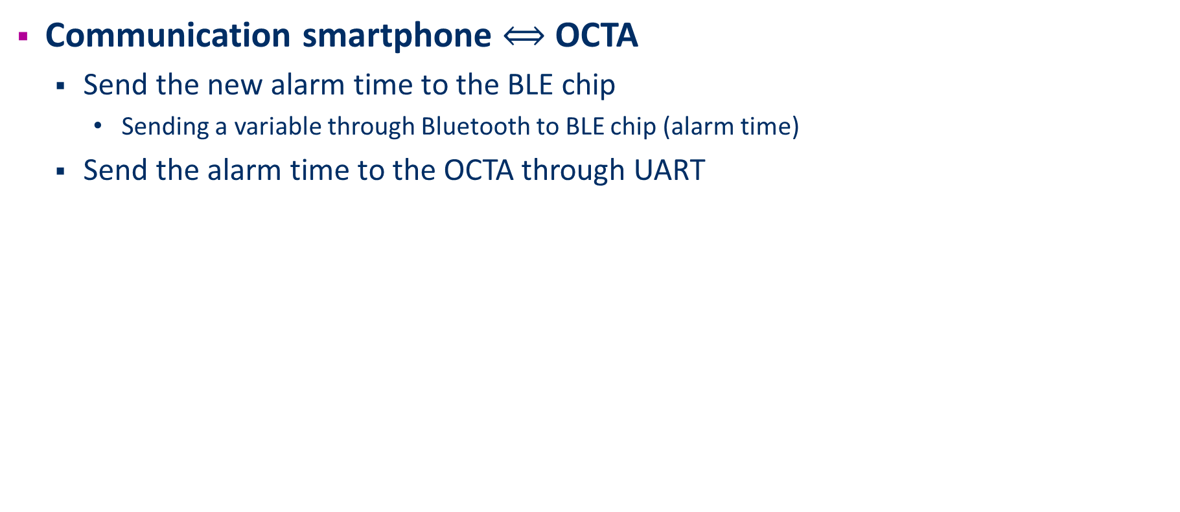
Goal
Communication smartphone $⟺$ OCTA
Send the new alarm time to the BLE chip
Sending a variable through Bluetooth to BLE chip (alarm time)
Send the alarm time to the OCTA through UART
OCTA
UART

Slide 5
Problems
Custom Service
Different SDK versions (different libraries)
Different functionalities working in different SDK’s
UART
Enabling UART and a lot of defines, includes and Makefile libraries
Different nRF-Connect apps for apple and android (with different functions)
Hard to debug
Coupling BLE and custom app

Slide 6
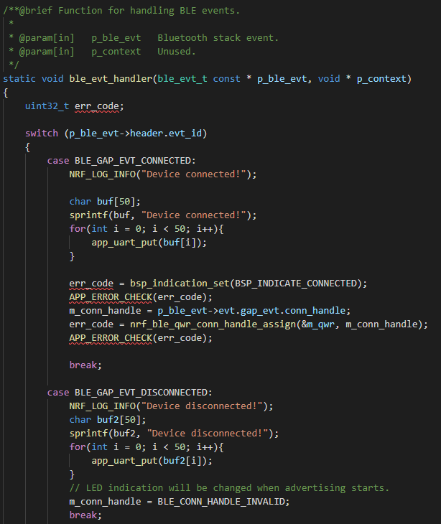
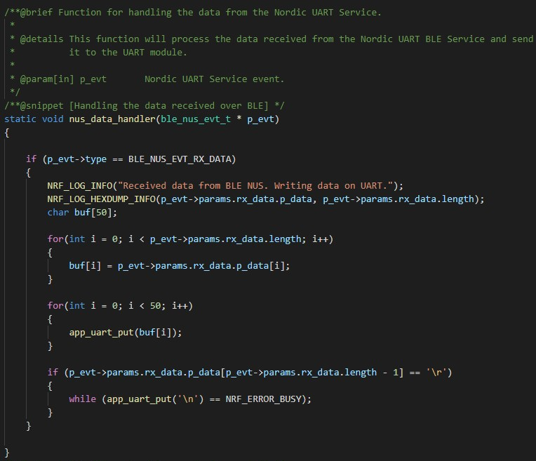
Achieved
Connection established
Notes:
NUS = Nordic UART service

Slide 7
OCTA - LoRaWAN

Slide 8



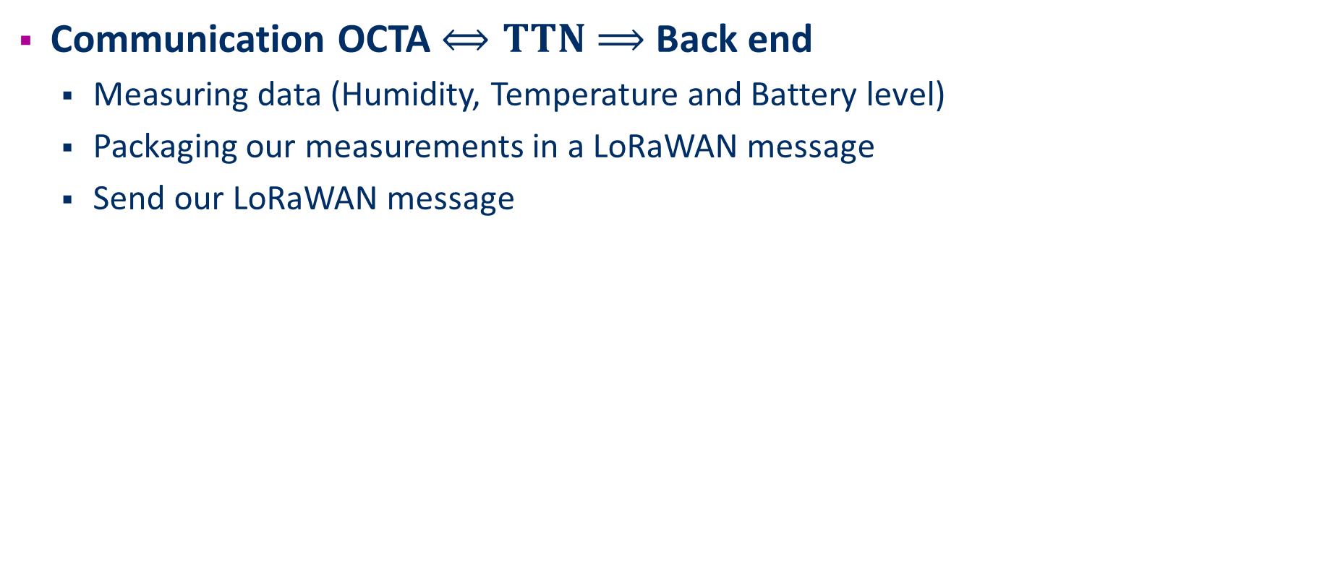
Goal
Communication OCTA $⟺TTN$ $⟹$Back end
Measuring data (Humidity, Temperature and Battery level)
Packaging our measurements in a LoRaWAN message
Send our LoRaWAN message

Slide 9
Problems
Receiving UART messages
Timing of receiving messages
Datatype unclarity of UART messages
Watchdog timer
Resets OCTA in sleep mode
Wake up sleeping OCTA

Slide 10
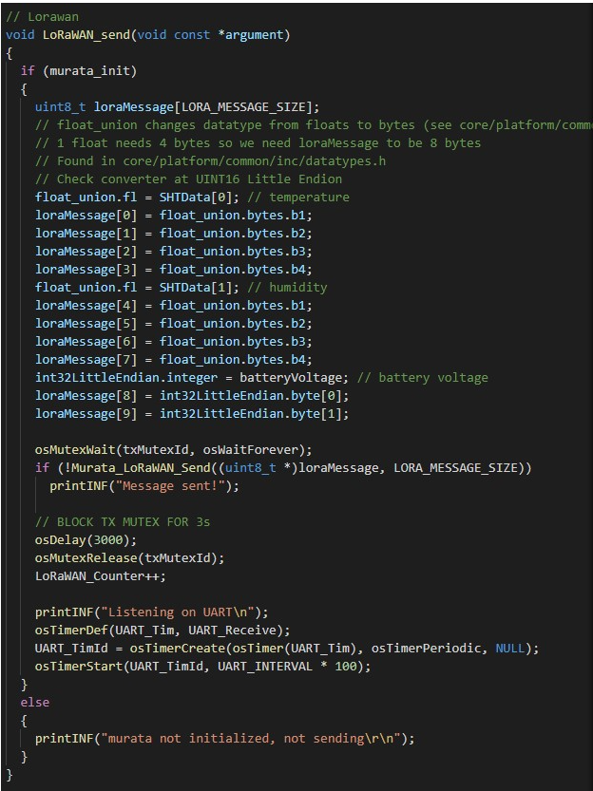
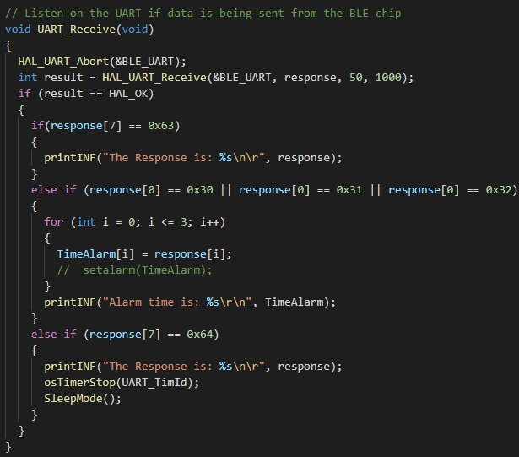
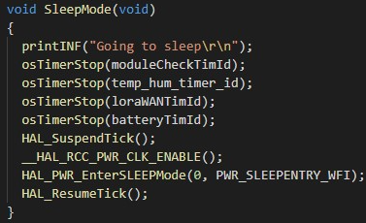
Achieved
Messages composed and sent successfully

Slide 11
RTC Alarm (failed to implement)

Slide 12


Goal
Receive alarm interrupt to wake up from low power mode
Alarm is set by app
RTC keeps running while in low power mode
Set current time and alarm with data from BLE message
WAKE UP!

Slide 13
Train of thought
Set up interrupts
1
Set the current time
2
Set the alarm
3
Set correct IRQ_Handler (failed)
4

Slide 14
Problems
Time and alarm already set in RTC_init()
Fix: Alarm can be edited (unlock rtc)
WWDG IRQ handler does not find correct IRQ handler
Gets stuck in infinite loop
Notes:
The first problem I encountered was that I could not set the time or alarm, as it was already set in RTC_Init(). After some research I discovered that the real time clock was locked. Easy fix: unlock rtc. Another problem was with the interrupts. I spent a lot of time trying to figure it out why the WWDG IRQ handler got stuck in an infinite loop, but could not find a solution. In the end, I decided to spend my time on trying to get sleepmode to work.

Slide 15
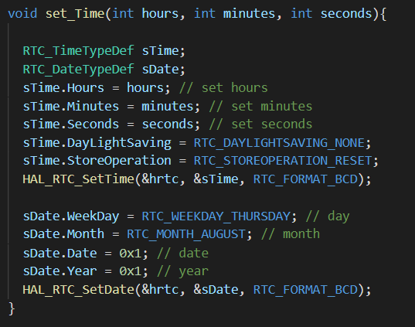
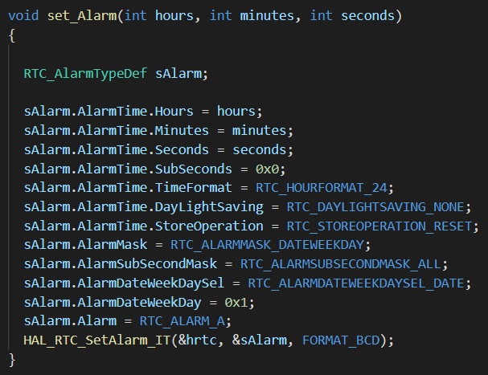
Achieved (but not implemented)
Set Time
Set Alarm
Notes:
Unfortunately I could not implement this in time. It worked on my local project, but I had some troubles with the interrupts. They didn’t come through. However the alarm and time was set correctly as I could print them out in a terminal.

Slide 16
Low Power Mode

Slide 17
Goal
After sending and receiving data go to sleep
Low power usage
Keep clock running for RTC alarm
Get out of sleep mode
On interrupt from RTC alarm
On press of button from octa

Slide 18
Problem
IRQ handler already defined
Fix:
Failed for RTC alarm interrupt
USE_HAL_RTC_REGISTER_CALLBACKS = 0
Changing value did not work
Define value in make file did not work

Slide 19
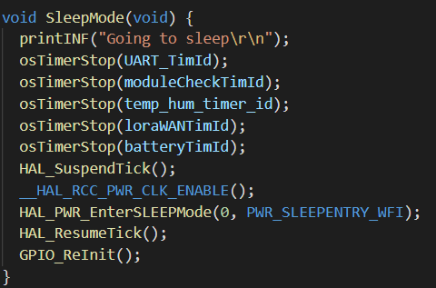
Achieved
Go to sleep
Notes:
disable the systick interrupt first, or else this interrupt will wake the MCU from Low Power mode after 1ms.
Another possible option is to go to standby mode or STOP mode instead of sleep mode.
In sleep mode CPU CLK is turned OFF and there is no effect on other clocks or analog clock sources. The current consumption is HIGHEST in this mode, compared to other Low Power Modes.
In stop mode all clocks in the 1.8V domain are stopped, the PLL, the HSI and the HSE oscillators are
disabled. SRAM and register contents are preserved. In the stop mode, all I/O pins keep the same state as in the run mode.
In standby mode the 1.2 V domain is consequently powered off. Voltage regulator is disabled. 1.8-1.2V domain is powered OFF. SRAM & register contents are lost except registers in the standby circuit.

Slide 20
Power Profiling

Slide 21
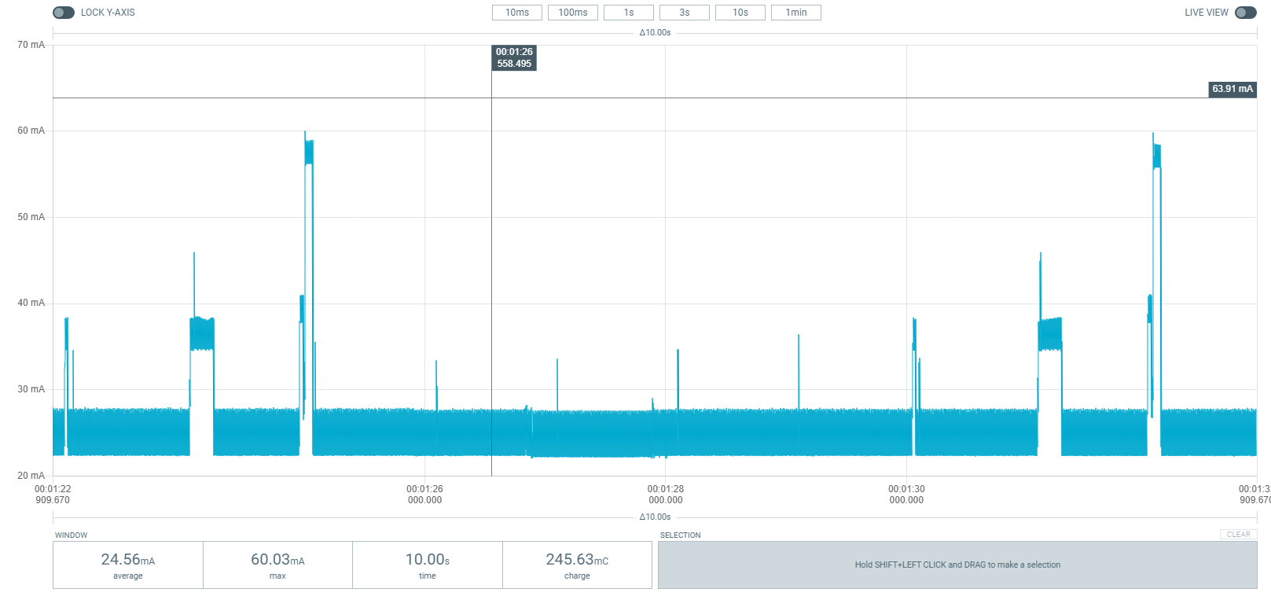
Power Profiling: Active (reading + LoRaWAN msg)

Slide 22
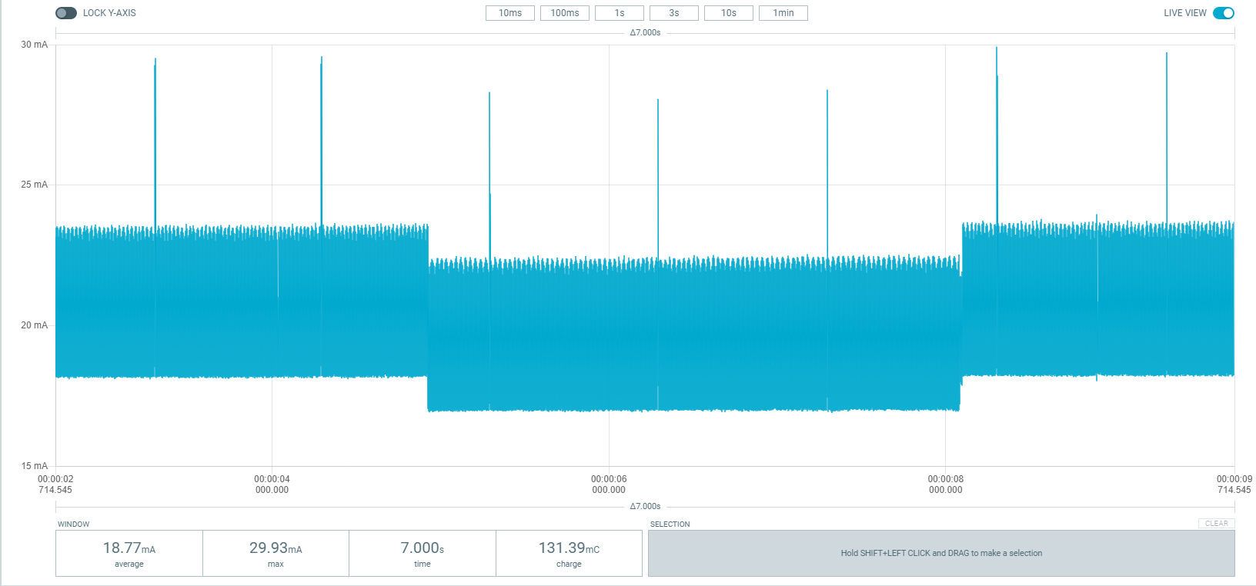
Power Profiling: Sleep

Slide 23
Backend

Slide 24




Goal
Receive sensor data from Frost Detector (OCTA)
Make sensor data available to the mobile app
Send a push notification on a new reading
User system to segregate multiple Frost Detector systems

Slide 25
Problems
User system isn’t implemented fully
→ As a proof of concept, this feature isn’t required

Slide 26
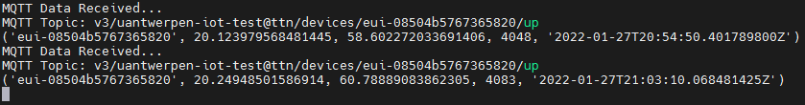
Achieved
The Frost Detector Service
Listens to new readings on an MQTT topic from the TTN cloud
Decodes and maps the incomming data
Stores new readings in an SQLite3 database
Sends a push notification via FCM on a new reading
API
HTTP GET (readings)
HTTP POST (user token)

Slide 27
Frontend - App

Slide 28

Goal
Display readings history
Set the alarm time of the Frost Detector over BLE
Alert the user about the condition of its car windshield at the set alarm time
Predict frost or vapor on the windshield based on interior and exterior sensor readings

Slide 29
Problems
The prediction of frost or vapor on a windshield
→ We need 2 OCTAs for this to work
→ Time constraint + redundant work

Slide 30
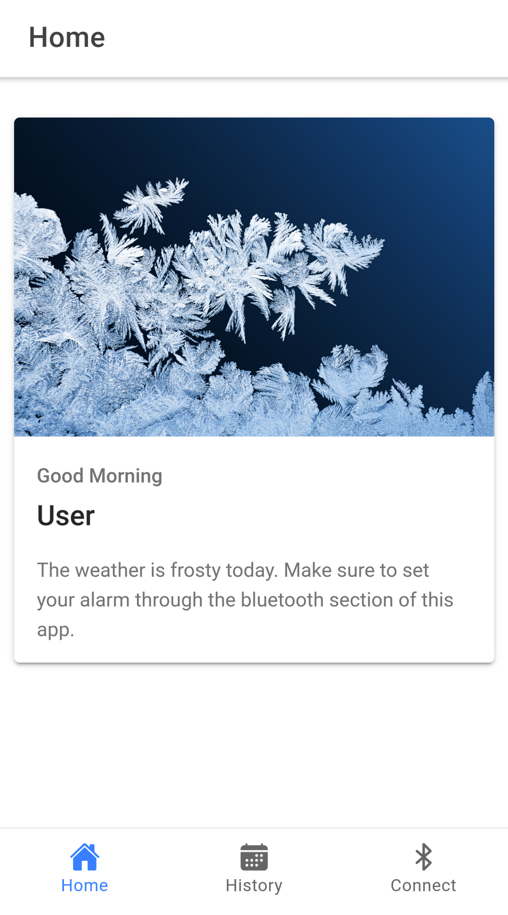
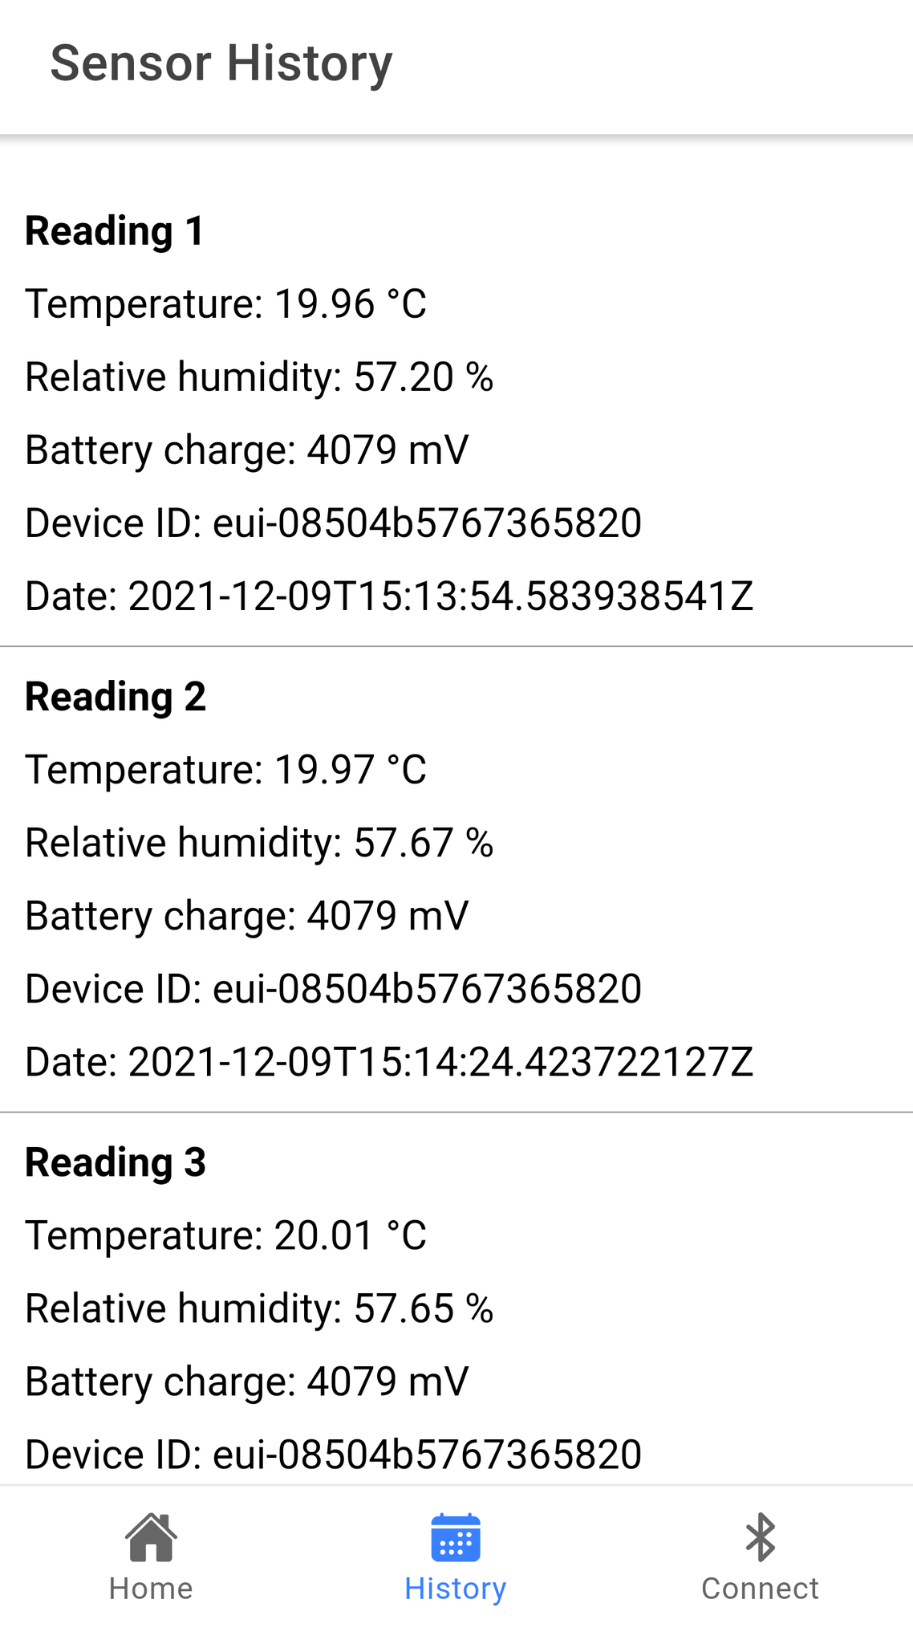
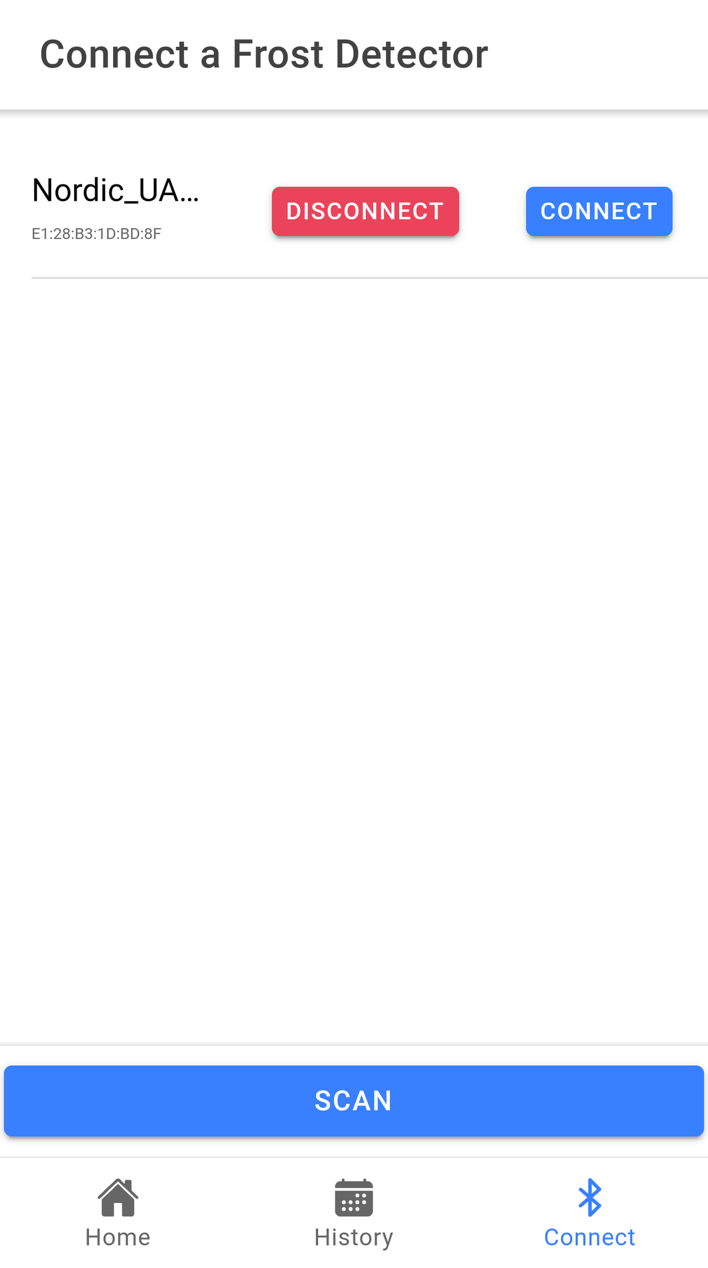
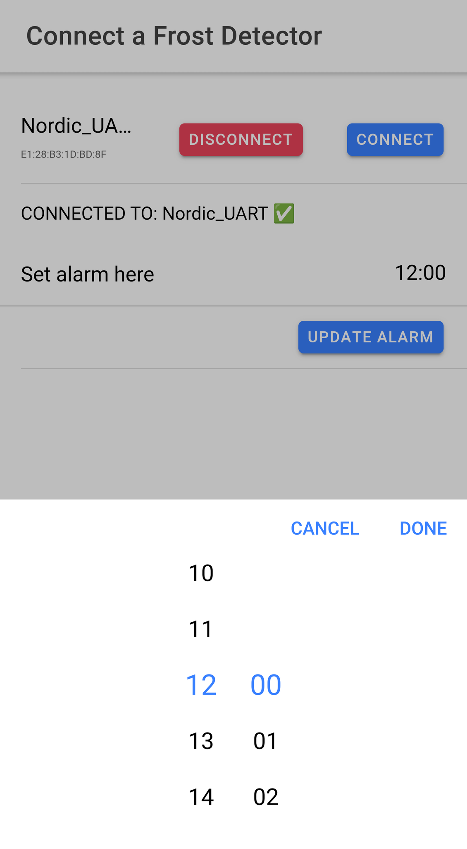
Achieved
Notes:
NUS = Nordic UART service

Slide 31



